Slide 1
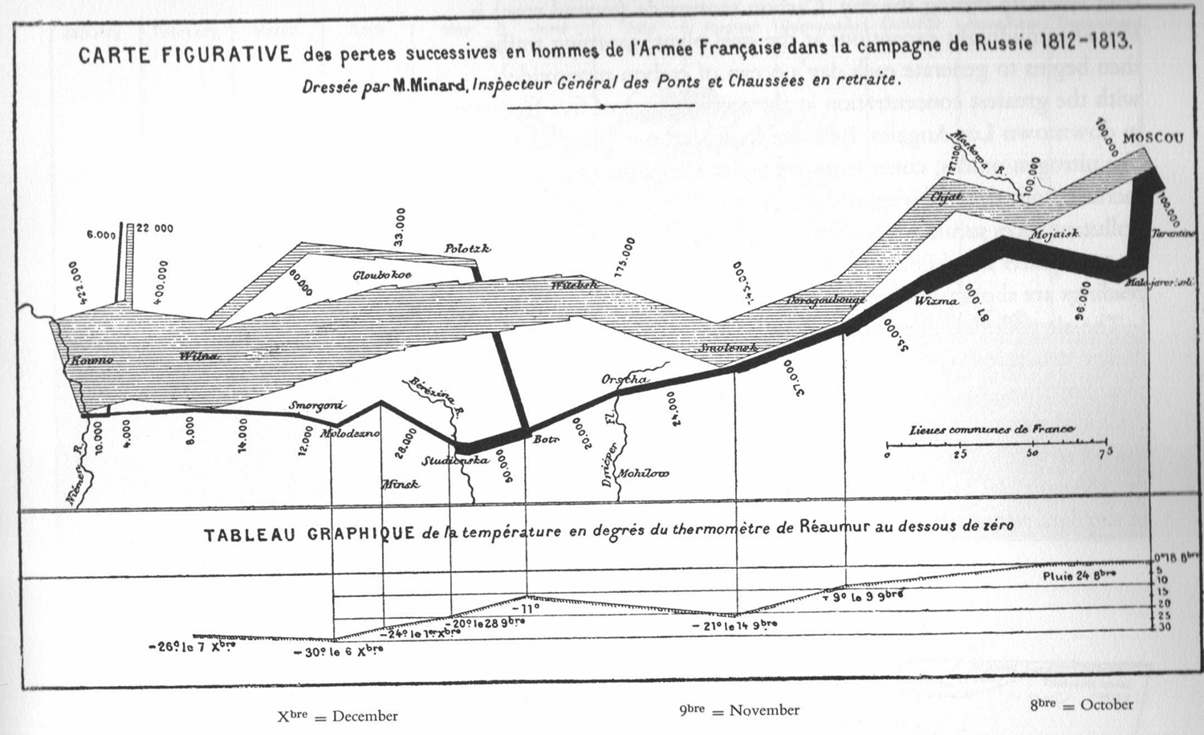
Notes:
The fate of Napoleon’s army invading Russia 1812 (Princes Bride). Starts with 422,000 men, returns with 10,000. Six variables are plotted – size or army, location in two dimensions, direction, dates, temperature.

Slide 2
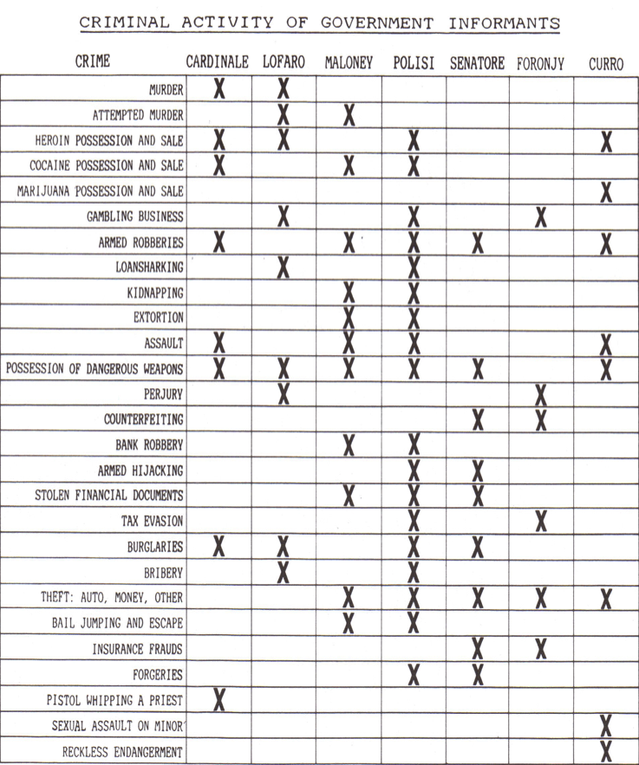
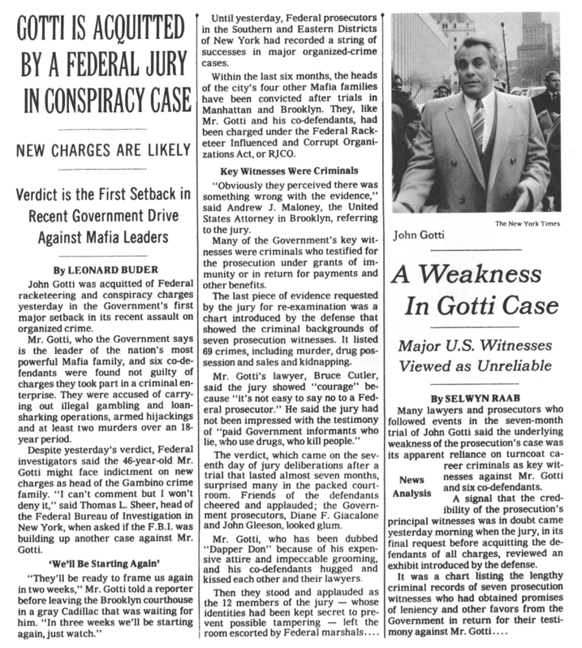
Notes:
Figure used by defense to discredit prosecutors witnesses. Only 37% of the boxes are checked

Slide 3
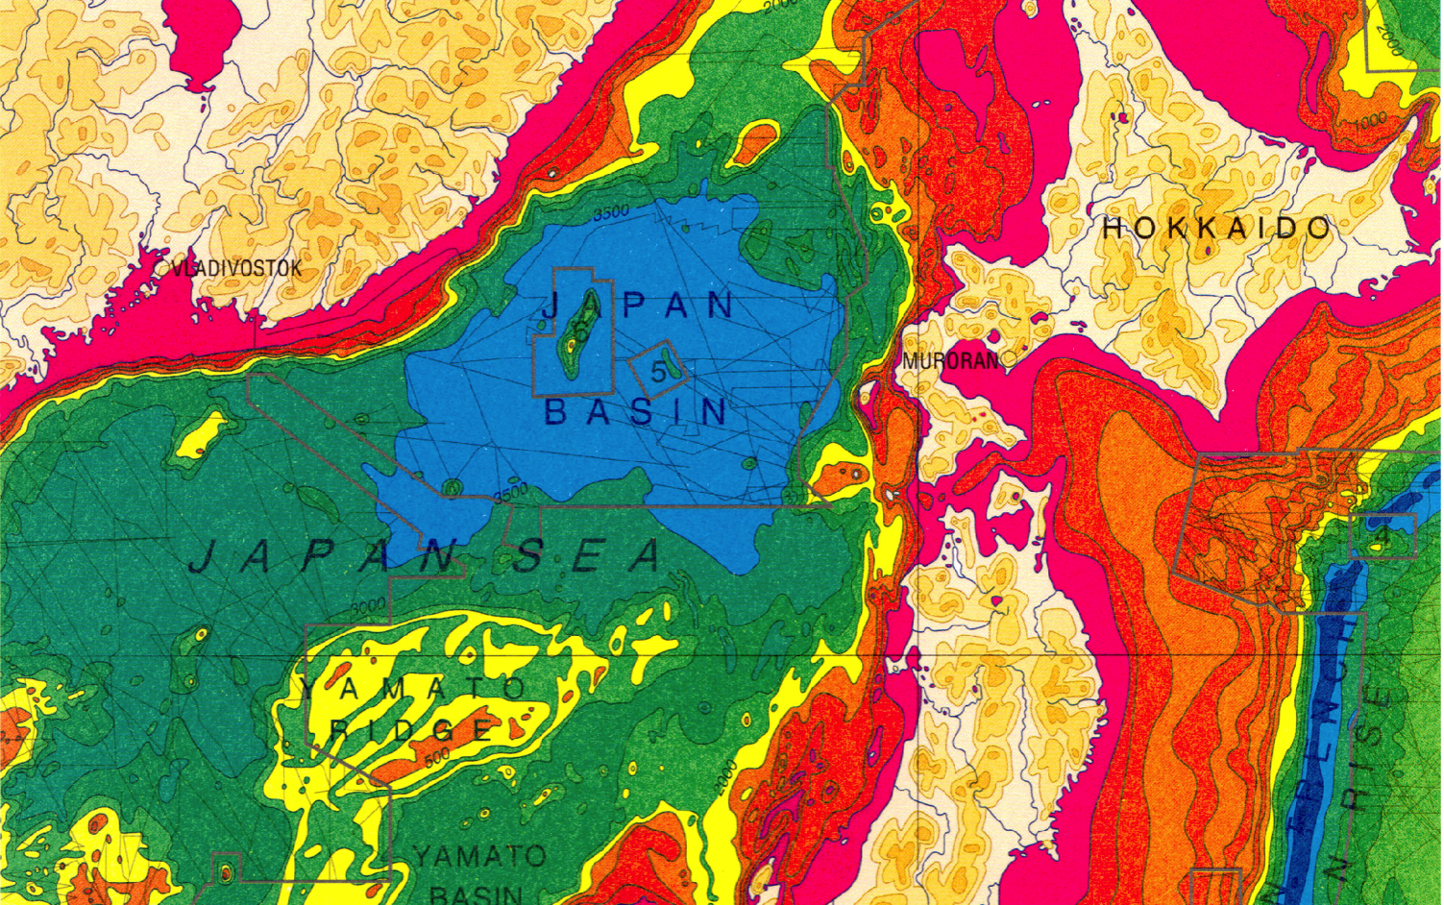
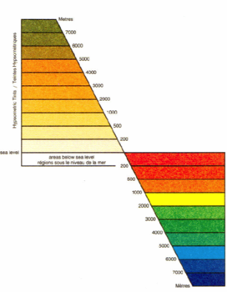

Slide 4
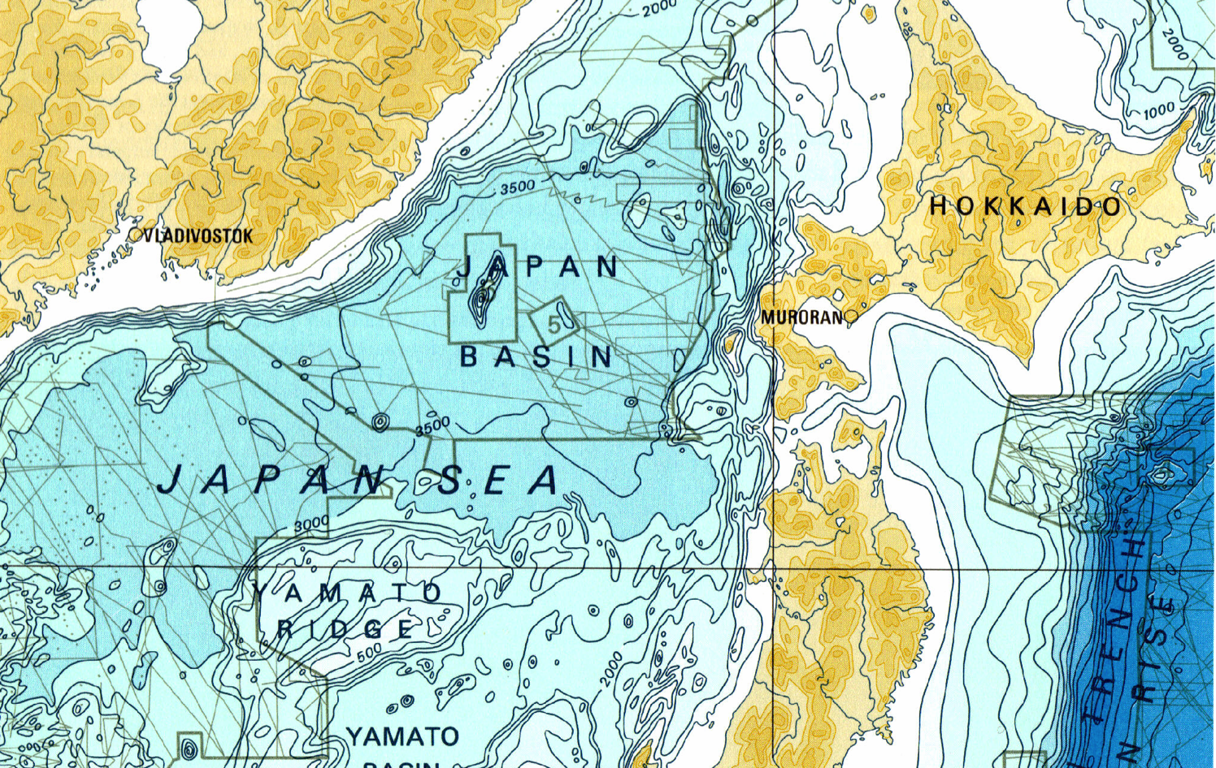
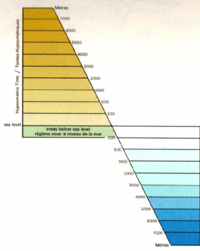

Slide 6
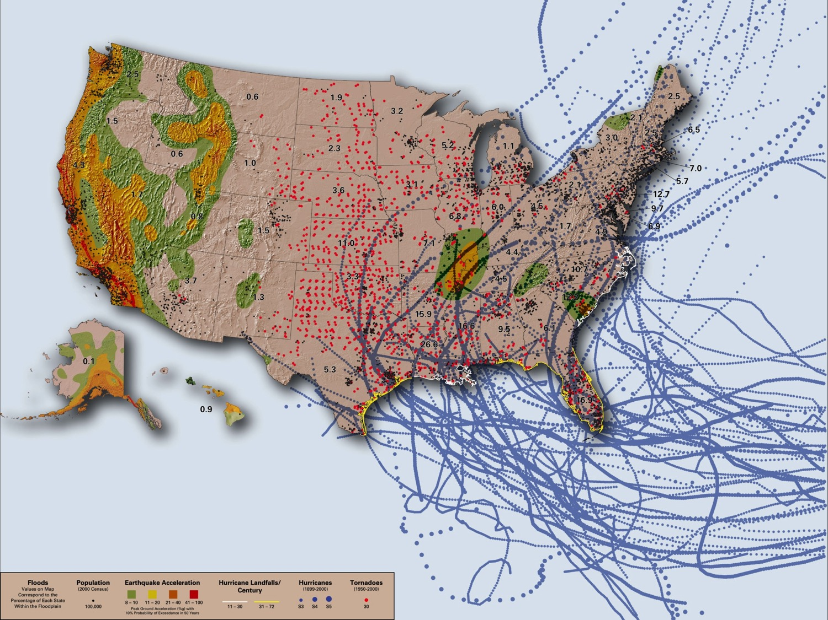

Slide 7


